Slide 1

AI training group
Weekly Report
Nguyen khai phu – Aug 25 2023

Slide 2

Download attachments from JIRA
ISP008 foundation
Apps from Atlassian Marketplace
REST API?
2
CISP-1352-A21 - ISP-DOC-STYLETYPE-Templates © Robert Bosch GmbH 2016. All rights reserved, also regarding any disposal, exploitation, reproduction, editing, distribution, as well as in the event of applications for industrial property rights.

Slide 3
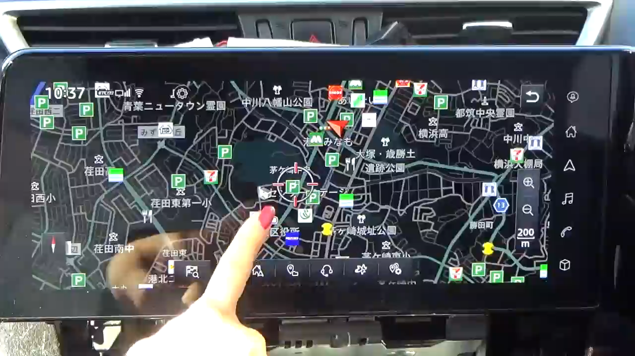
Case 1
ISP008 foundation
2
CISP-1352-A21 - ISP-DOC-STYLETYPE-Templates © Robert Bosch GmbH 2016. All rights reserved, also regarding any disposal, exploitation, reproduction, editing, distribution, as well as in the event of applications for industrial property rights.

Slide 4
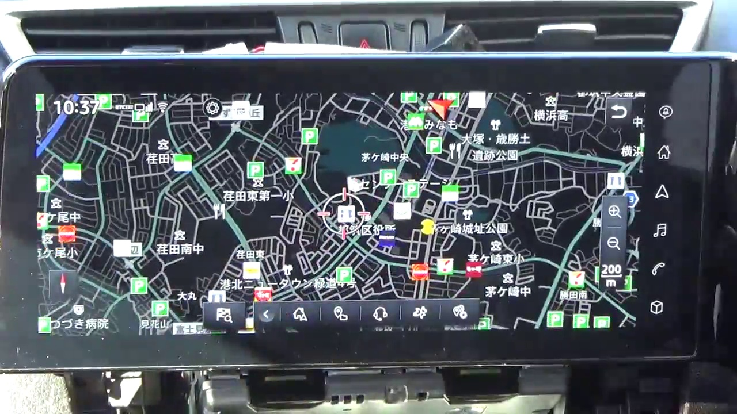
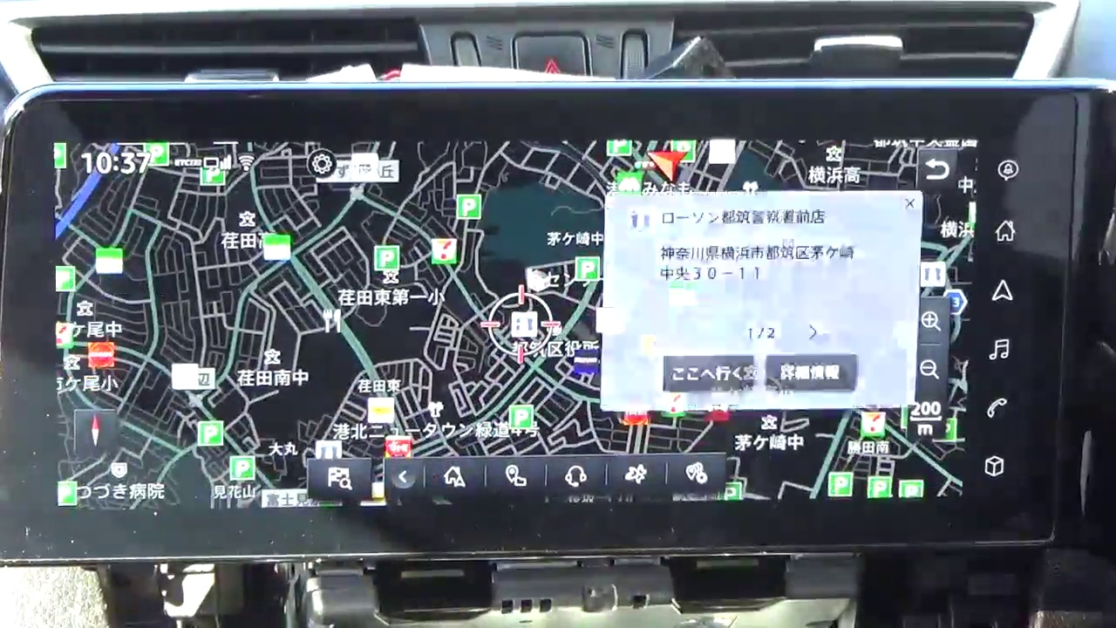
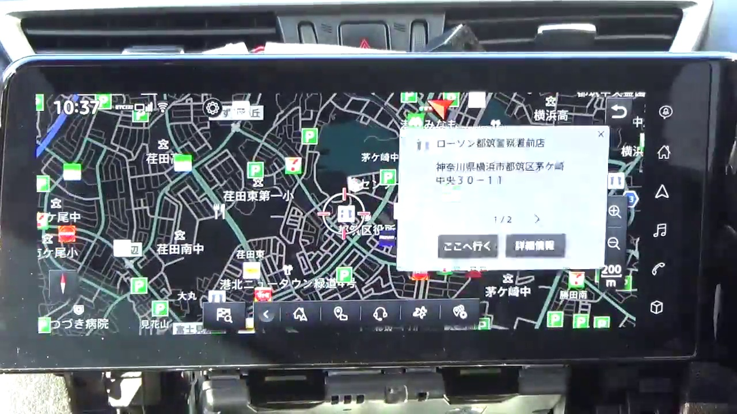


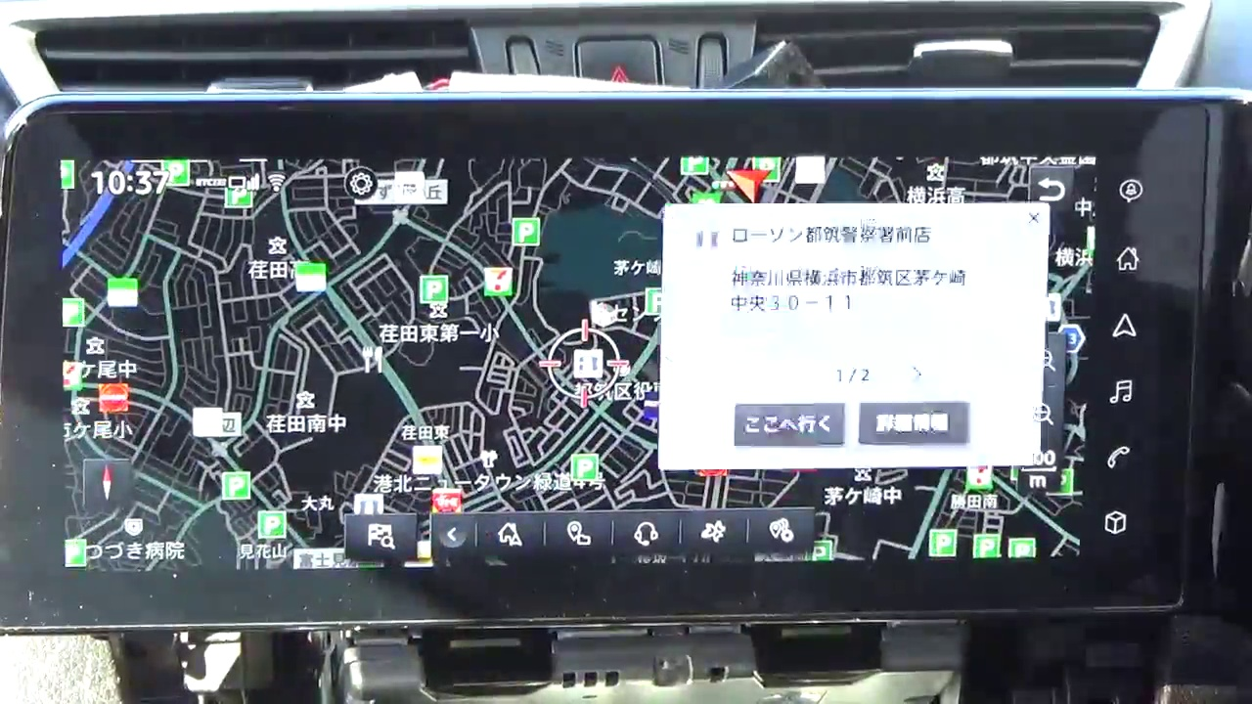
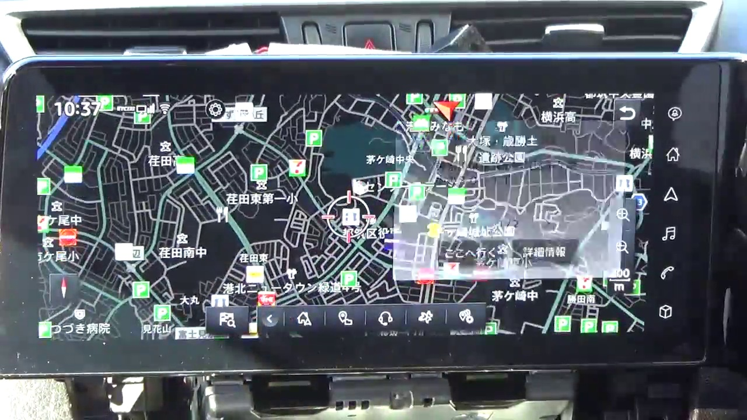
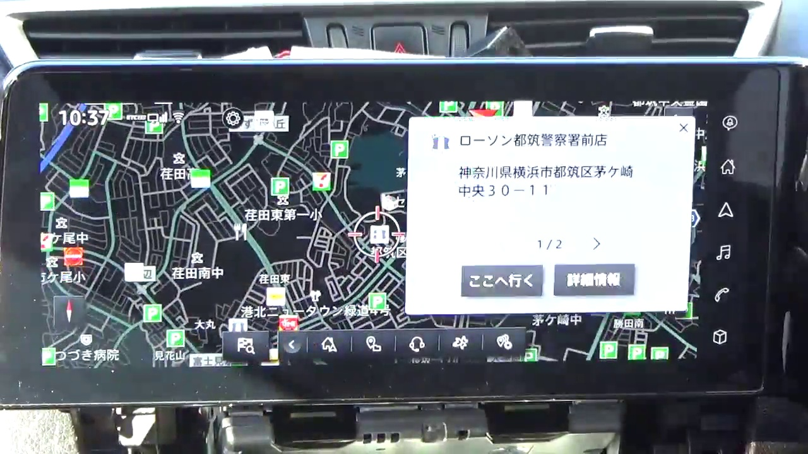
Group 1: Chaotic, rapid switch
ISP008 foundation
1
2
3
4
5
6
7
8
2
CISP-1352-A21 - ISP-DOC-STYLETYPE-Templates © Robert Bosch GmbH 2016. All rights reserved, also regarding any disposal, exploitation, reproduction, editing, distribution, as well as in the event of applications for industrial property rights.

Slide 5
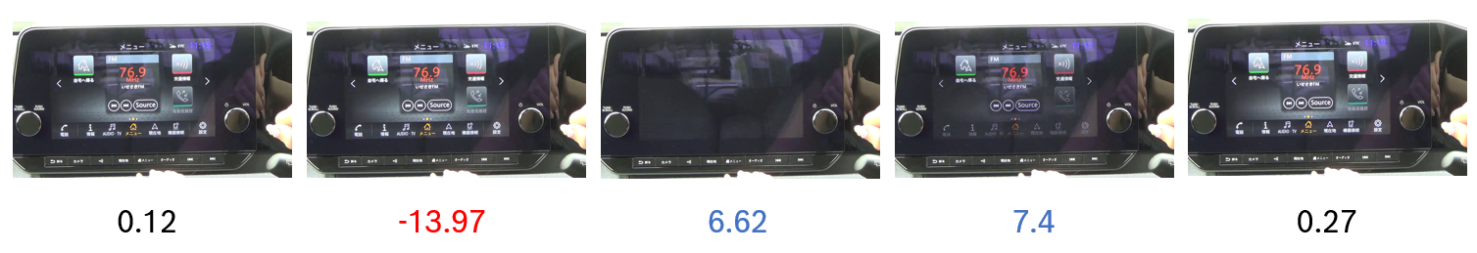
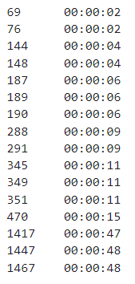
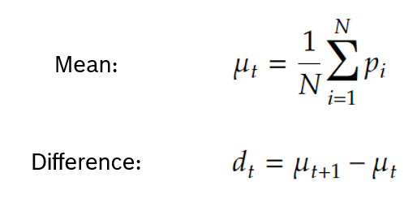
Group 1: Chaotic, rapid switch
ISP008 foundation
2
CISP-1352-A21 - ISP-DOC-STYLETYPE-Templates © Robert Bosch GmbH 2016. All rights reserved, also regarding any disposal, exploitation, reproduction, editing, distribution, as well as in the event of applications for industrial property rights.

Slide 6
Group 1: Chaotic, rapid switch
ISP008 foundation
Works well for videos with lighting conditions
Some “reasonable” false positives: black-screen transitions
Bad lighting conditions:
2
CISP-1352-A21 - ISP-DOC-STYLETYPE-Templates © Robert Bosch GmbH 2016. All rights reserved, also regarding any disposal, exploitation, reproduction, editing, distribution, as well as in the event of applications for industrial property rights.

Slide 7
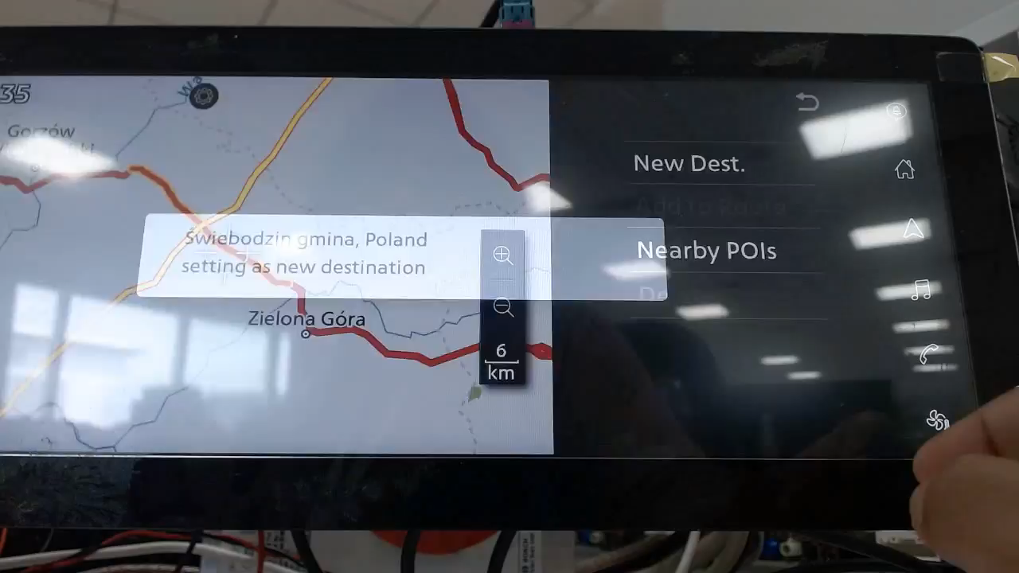
ISP008 foundation
2
CISP-1352-A21 - ISP-DOC-STYLETYPE-Templates © Robert Bosch GmbH 2016. All rights reserved, also regarding any disposal, exploitation, reproduction, editing, distribution, as well as in the event of applications for industrial property rights.

Slide 8
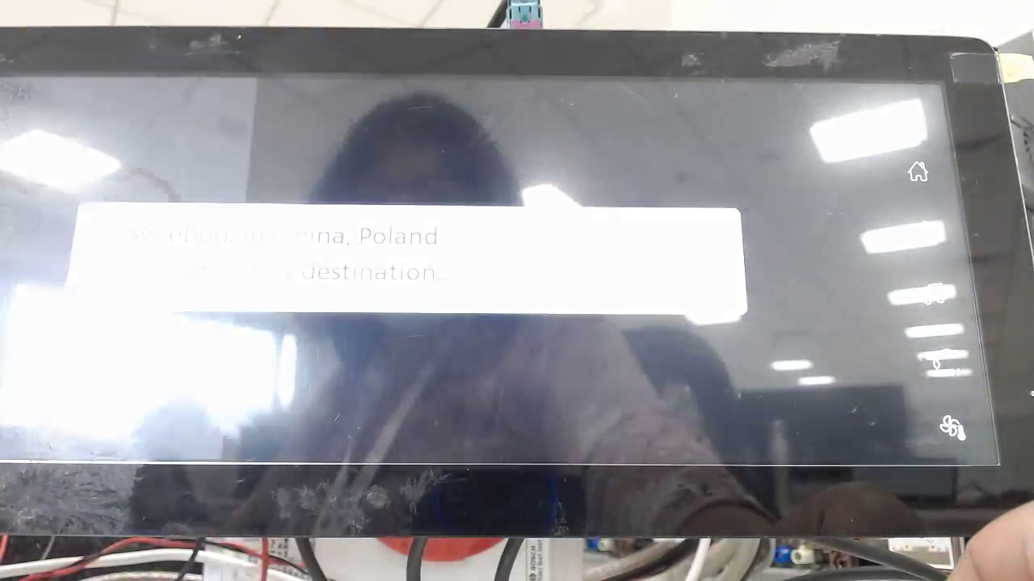
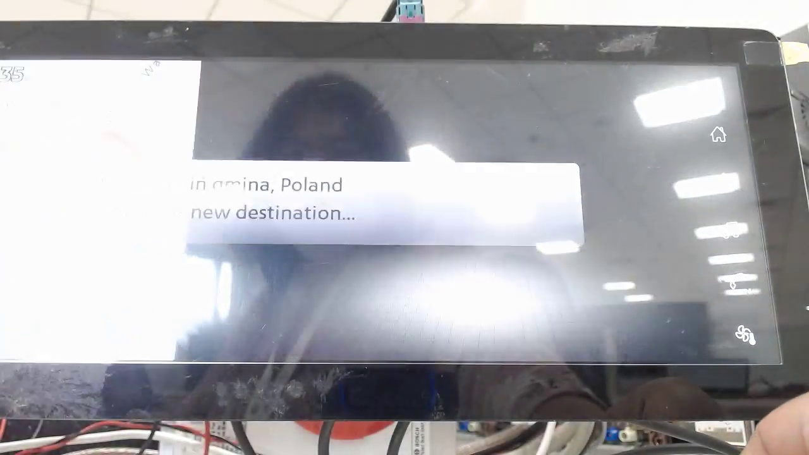
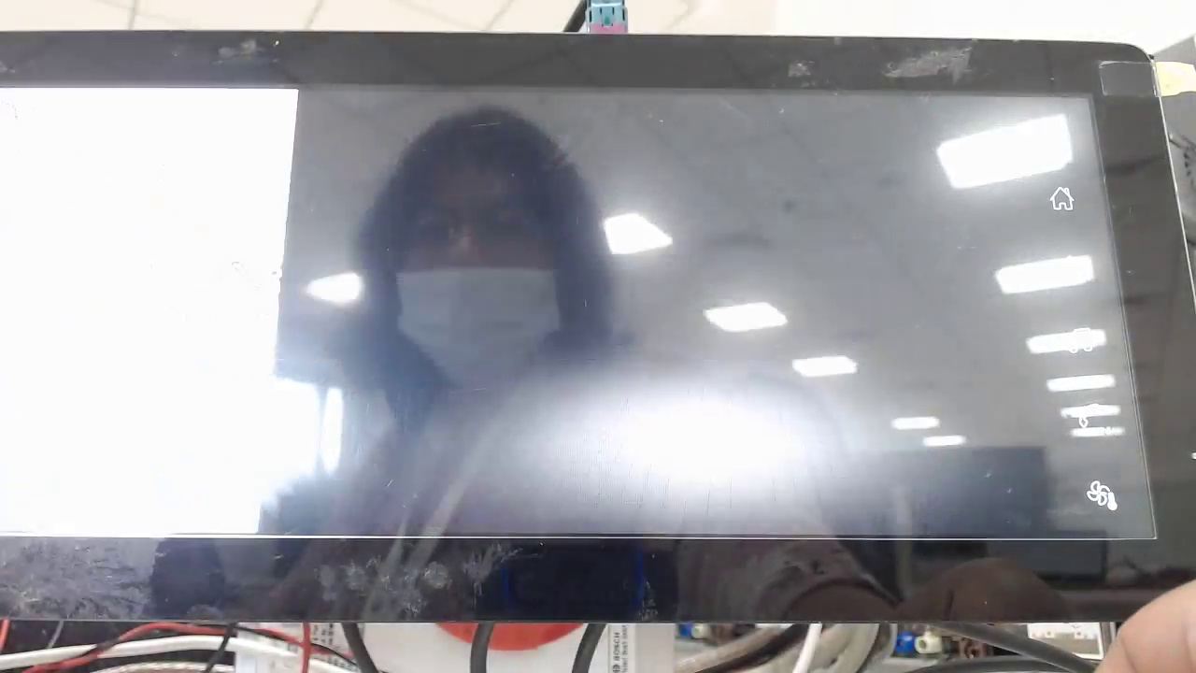
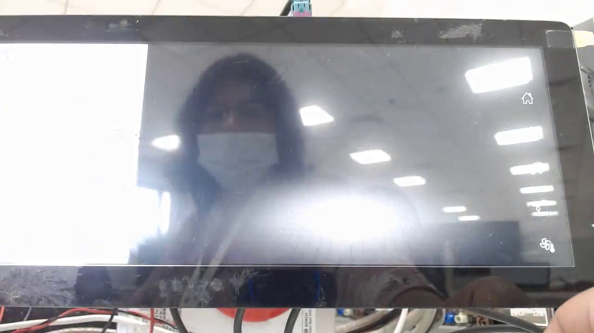

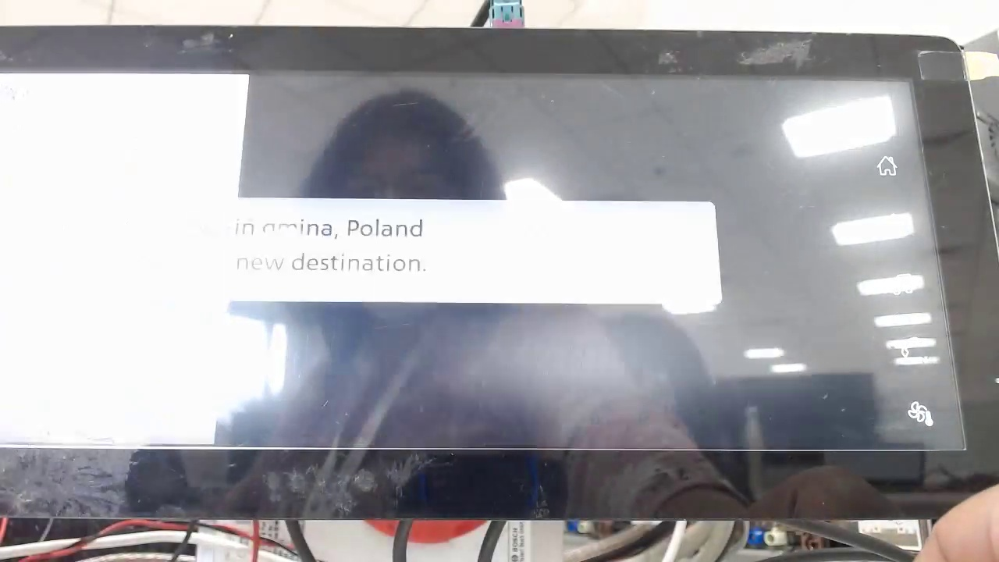
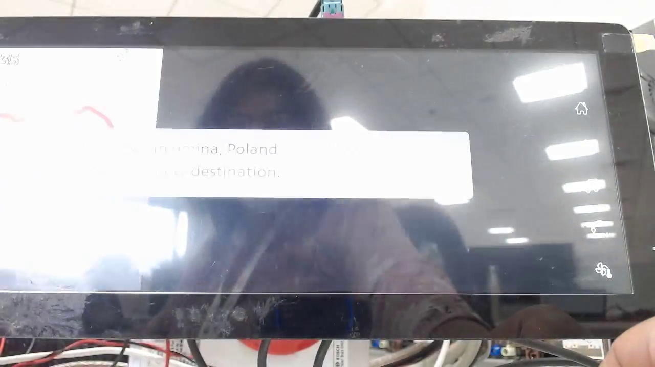

Group 1: Chaotic, rapid switch
ISP008 foundation
Works well for videos with lighting conditions
Some “reasonable” false positives: black-screen transitions
Bad lighting conditions:
2
CISP-1352-A21 - ISP-DOC-STYLETYPE-Templates © Robert Bosch GmbH 2016. All rights reserved, also regarding any disposal, exploitation, reproduction, editing, distribution, as well as in the event of applications for industrial property rights.

Slide 9
Group 1: Chaotic, rapid switch
ISP008 foundation
Works well for videos with lighting conditions
Some “reasonable” false positives: black-screen transitions
Bad lighting conditions -> a lot harder to detect
Many false positives caused by tester’s hands and bad camera focus
More steps in reproduction process -> more human interactions -> more frames with hands
2
CISP-1352-A21 - ISP-DOC-STYLETYPE-Templates © Robert Bosch GmbH 2016. All rights reserved, also regarding any disposal, exploitation, reproduction, editing, distribution, as well as in the event of applications for industrial property rights.

Slide 10
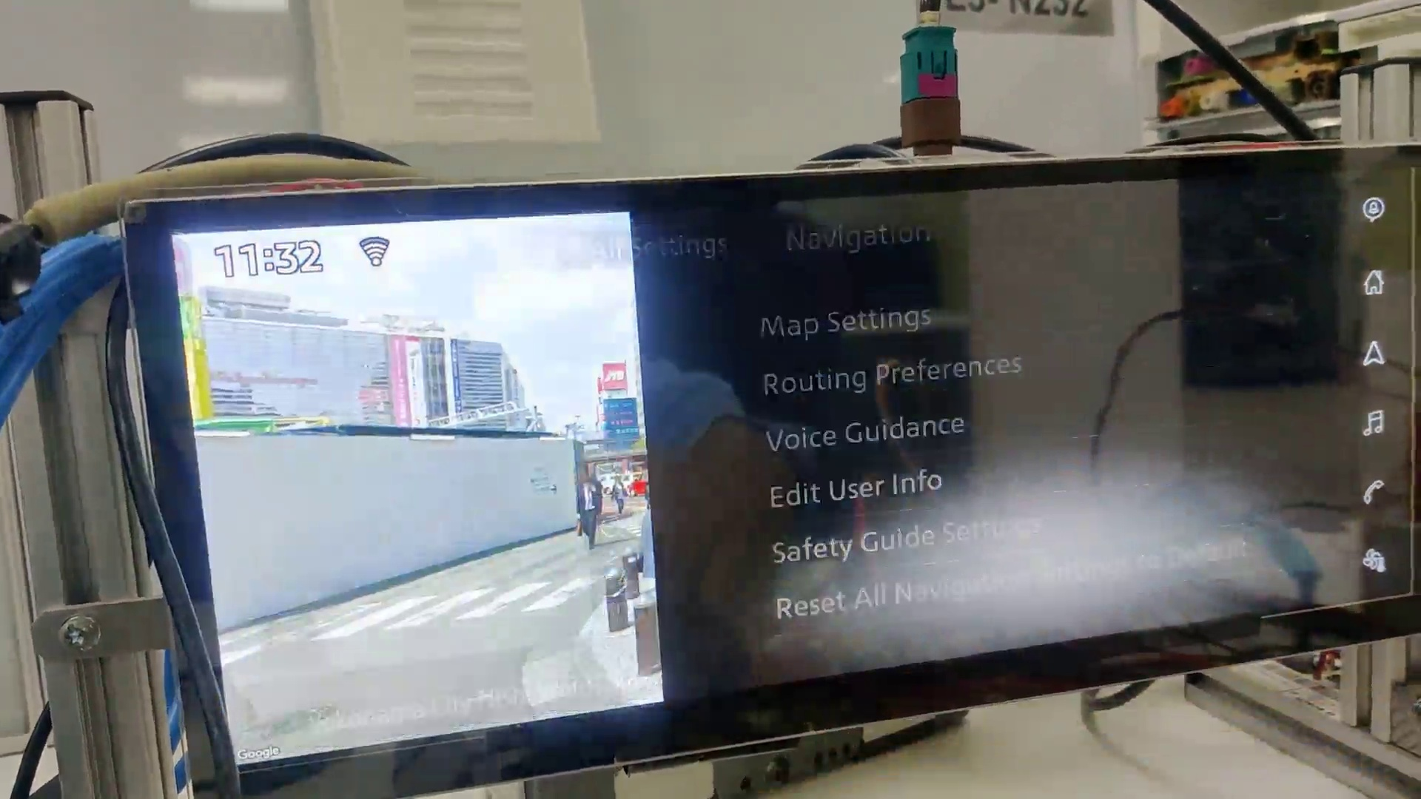
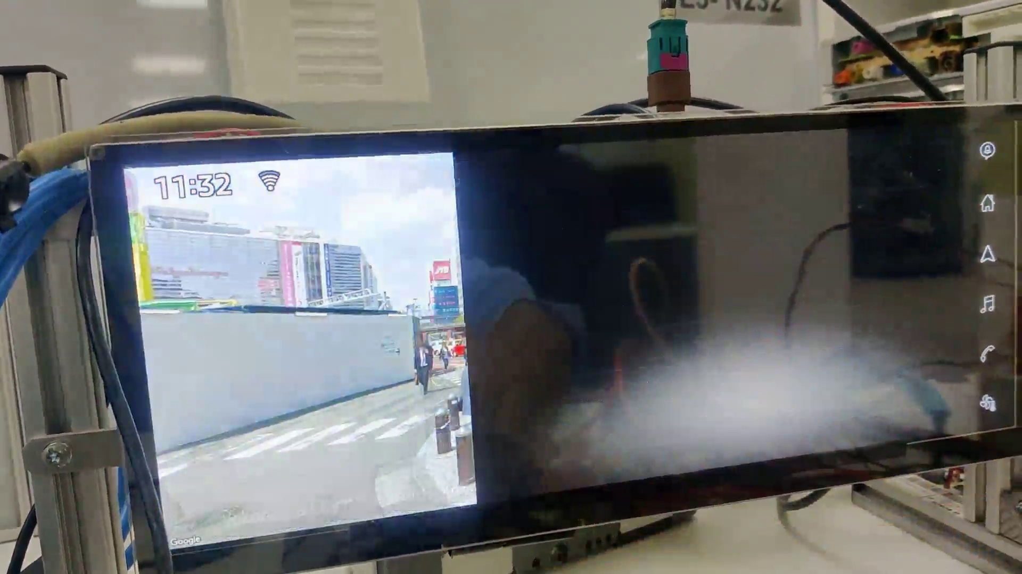
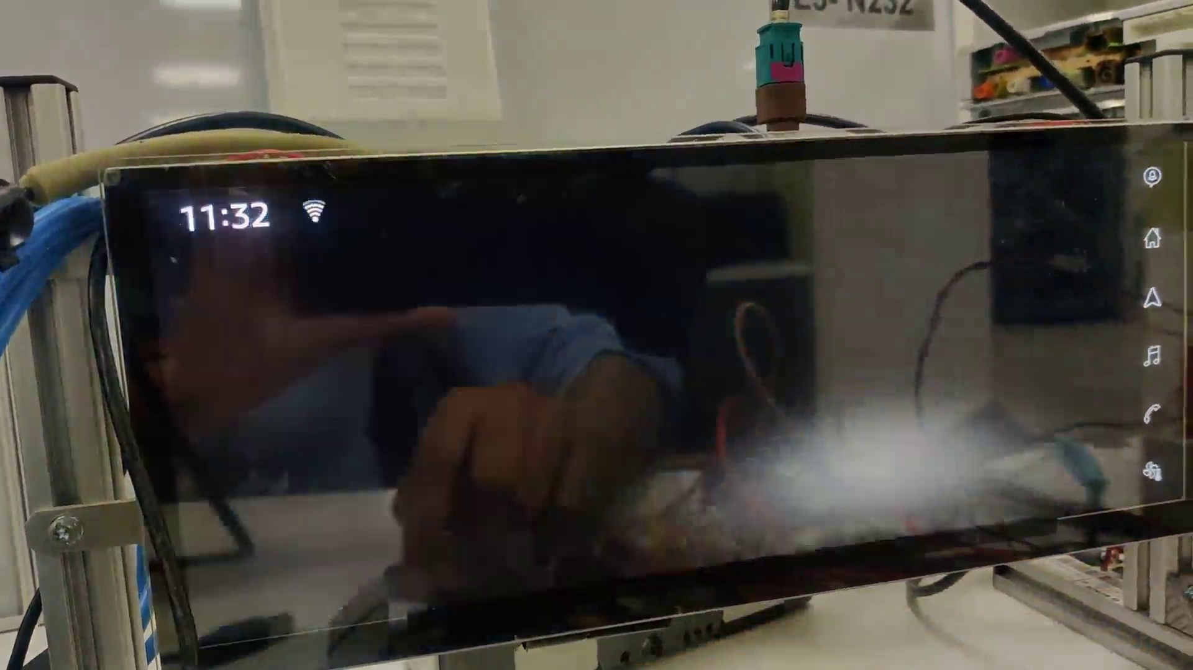
Group 2: Frame error
ISP008 foundation
Happens in the span of just a number of frames
Not always black screen
Difficult to detect if it happens in screen transitions
Might depend on customers’ requirements
2
CISP-1352-A21 - ISP-DOC-STYLETYPE-Templates © Robert Bosch GmbH 2016. All rights reserved, also regarding any disposal, exploitation, reproduction, editing, distribution, as well as in the event of applications for industrial property rights.

Slide 11
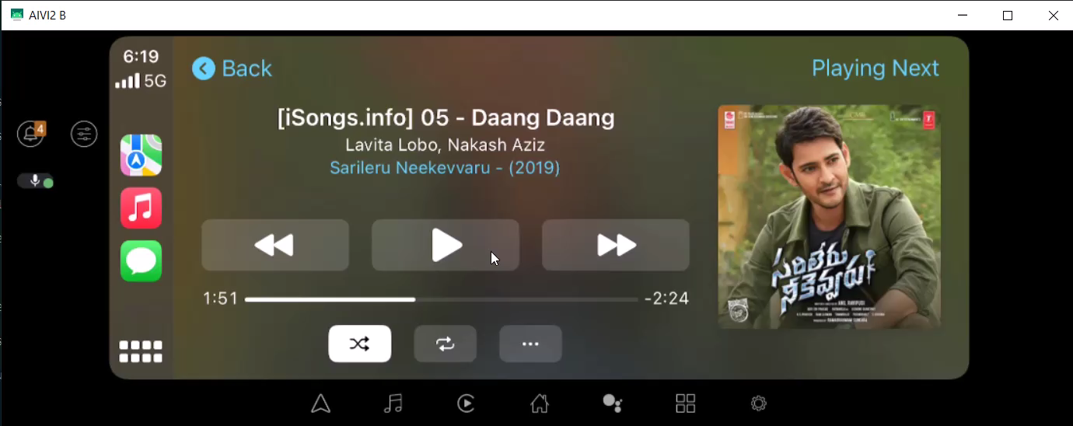
Group 2: Frame error
ISP008 foundation
A lot more common than other types (14/15 test cases observed)
Some of them are found and recorded on screen captures (not affected by camera and lighting)
Mostly happen on tab/page transitions
2
CISP-1352-A21 - ISP-DOC-STYLETYPE-Templates © Robert Bosch GmbH 2016. All rights reserved, also regarding any disposal, exploitation, reproduction, editing, distribution, as well as in the event of applications for industrial property rights.

Slide 12
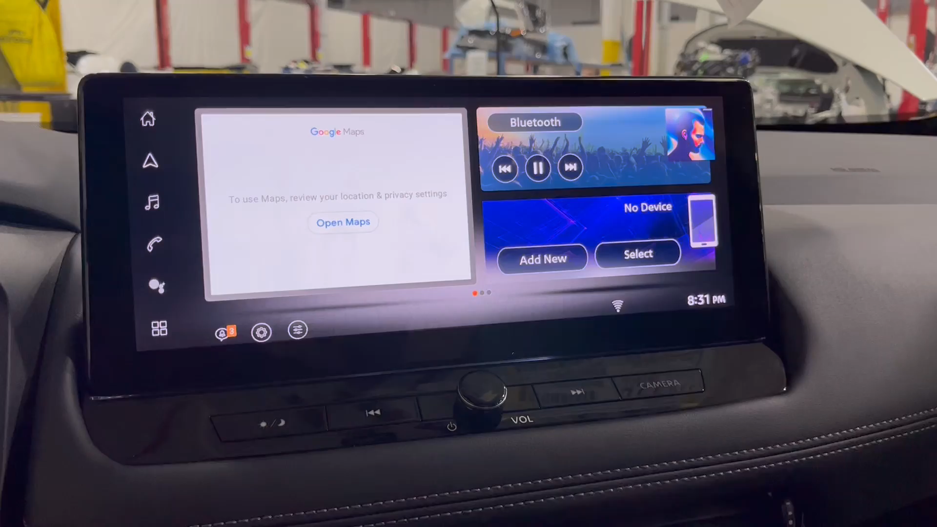
ISP008 foundation
2
CISP-1352-A21 - ISP-DOC-STYLETYPE-Templates © Robert Bosch GmbH 2016. All rights reserved, also regarding any disposal, exploitation, reproduction, editing, distribution, as well as in the event of applications for industrial property rights.

